Slide 1
Employee Data Analysis using Excel
STUDENT NAME : Divya. V
REG NO : 312209279
DEPARTMENT : BCOM (GEN) COMMERCE
COLLEGE : ANNA ADARSH COLLEGE FOR WOMEN

Slide 2
PROJECT TITLE
Employee Performance Analysis using Excel

Slide 3


AGENDA
Problem Statement
Project Overview
End Users
Our Solution and Proposition
Dataset Description
Modelling Approach
Results and Discussion
Conclusion
3/21/2024 Annual Review

Slide 4

PROBLEM STATEMENT
To analyse and optimize the performance of the employees by evaluating the key metrics such as emp id , employee status , employee level , performance level etc . The analysis aims to identify the employees with greater efficiencies

Slide 5

PROJECT OVERVIEW
The prime objective is to create an employee performance analysis using excel with the help of various functions such as conditional formatting , pivot table creation , chart etc..

Slide 6

WHO ARE THE END USERS?
Employers
Employees
organization

Slide 7

OUR SOLUTION AND ITS VALUE PROPOSITION
Filtering : To find the missing data
Chart : To get an graphical representation
Pivot table : To summarize the data
Conditional technique : Used to identify the missing data

Slide 8
Dataset Description
Employee dataset : Kaggle
Total : 26 Feature
Used : 9 features
Employee id
First name
Business unit
Employee status
Pay zone
Employee type
Gender
Performance score
Current employee rating
Performance level

Slide 9

THE "WOW" IN OUR SOLUTION
Formula :
“=IFS(Z2>=5,"VERY HIGH",Z2>=4,"HIGH",Z2>=3,"MEDIUM","TRUE","LOW")”
This formula is used to find the performance level of the employees which is derived as “medium , low and high” . And this performance level is used to get an graphical representation of the employees performance
CONDITIONAL FORMATTING :
The conditional formatting is used to identify the missing data in a cell , highlight the missing cells and also to remove the missing cell
3/21/2024 Annual Review
9

Slide 10
MODELLING
DATA SCREENING : Downloaded an employee dataset from Kaggle , and saved the dataset in an folder then inserted the same in excel
DATA CLEANING : Using conditional formatting from home identified and removed the missing data and selected 9 datas from the data set like (emp id , name , gender etc)
DATA FORMULATING : Using “IFS” condition created an column of performance level using data from current employee rating which gave an output as medium , low , high
PIVOT TABLE CREATION : Select pivot table from insert and an pivot table is enabled , now select the required data. An pivot table is now created , We can also create pivot table through Queries and Connection icon
GRAPHICAL REPRESENTATION : After creating an pivot table select the pivot table and go to insert icon and select recommendation chart and an visual representation is created .
10

Slide 11
RESULTS
GenderCode | (All)
Sum of Current Employee Rating | Column Labels
Row Labels | high | low | medium | very high | Grand Total
BPC | 148 | 135 | 456 | 170 | 909
CCDR | 180 | 146 | 423 | 125 | 874
EW | 164 | 127 | 480 | 115 | 886
MSC | 136 | 127 | 474 | 140 | 877
NEL | 200 | 121 | 474 | 115 | 910
PL | 200 | 108 | 453 | 160 | 921
PYZ | 176 | 142 | 438 | 120 | 876
SVG | 160 | 128 | 468 | 150 | 906
TNS | 152 | 126 | 480 | 120 | 878
WBL | 160 | 131 | 444 | 135 | 870
Grand Total | 1676 | 1291 | 4590 | 1350 | 8907
11

Slide 12
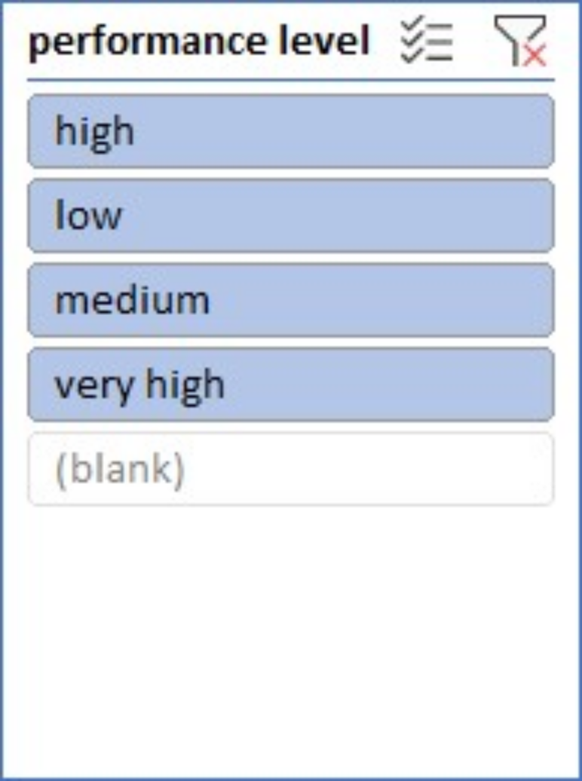
slicer

Slide 13
conclusion
The end output is created as employee performance analyses using various functions such as pivot table , graph etc . This helps to easily analyse the data . This performance analysis is used to find the employees with greater efficiency

